Slide 1
A11Y Language of Parts
Language of parts with opens new window

Slide 2
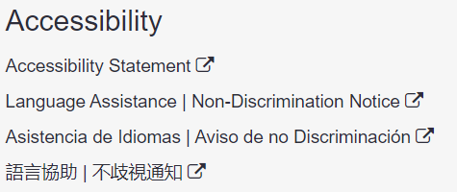
Language of parts

Slide 3
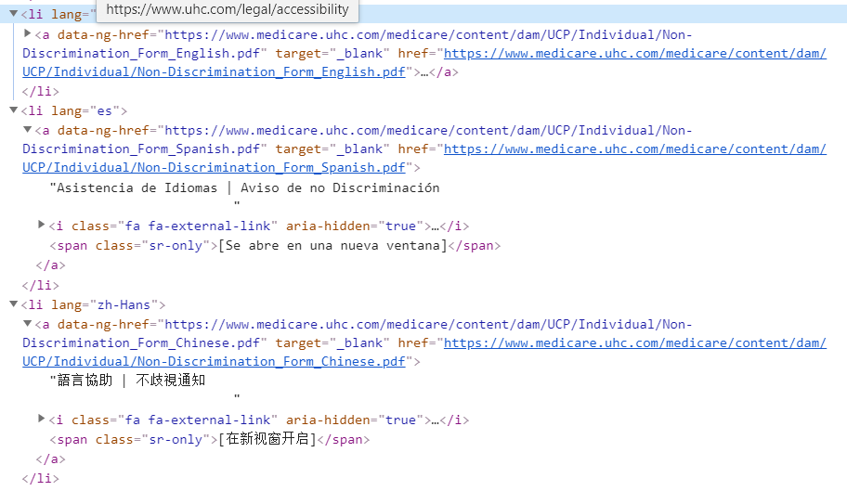
Language of parts

Slide 4
Lang attribute in AEM
<li lang="<%=linkLanguage[i]%>">
<a data-ng-href="<%=linkUrl[i]%>" target="_blank"><%=linkText[i]%>
<i class="fa fa-external-link" aria-hidden="true"></i>
<span class="sr-only">[<%=newWindowText[i]%>]</span>
</a>
</li>

Slide 5
Thank you

